Slide 1

Key Management
Copyright © The McGraw-Hill Companies, Inc. Permission required for reproduction or display.
15.<number>

Slide 2
15-1 SYMMETRIC-KEY DISTRIBUTION
Symmetric-key cryptography is more efficient than asymmetric-key cryptography for enciphering large messages. Symmetric-key cryptography, however, needs a shared secret key between two parties. The distribution of keys is another problem.
Topics discussed in this section:
15.1.1 Key-Distribution Center: KDC
15.1.2 Session Keys
15.<number>

Slide 3





15-1 Symmetric Key Distribution
Each pair of communicating entities needs a shared key
  For a n-party system, there are n(n-1)/2 distinct keys in the system and each party needs to maintain n-1 distinct keys.
How to reduce the number of shared keys in the system
How to securely distribute this key
K₁
K₄
K₂
K₃
K₅
K₆
K₈
K₇
K₉
K₁₀
15.<number>

Slide 4
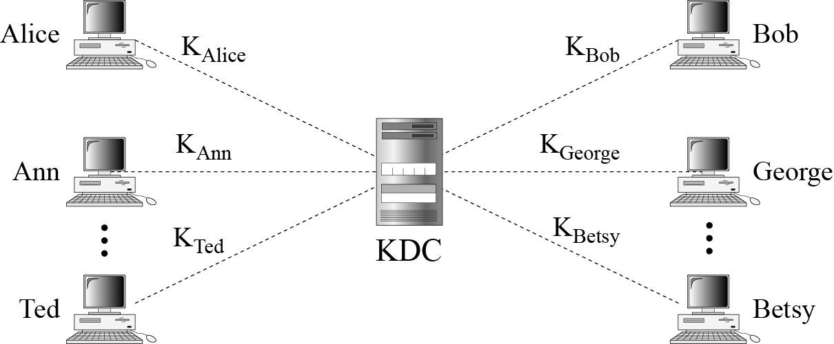
15.1.1 Key-Distribution Center: KDC
Figure 15.1 Key-distribution center (KDC)
15.<number>

Slide 5
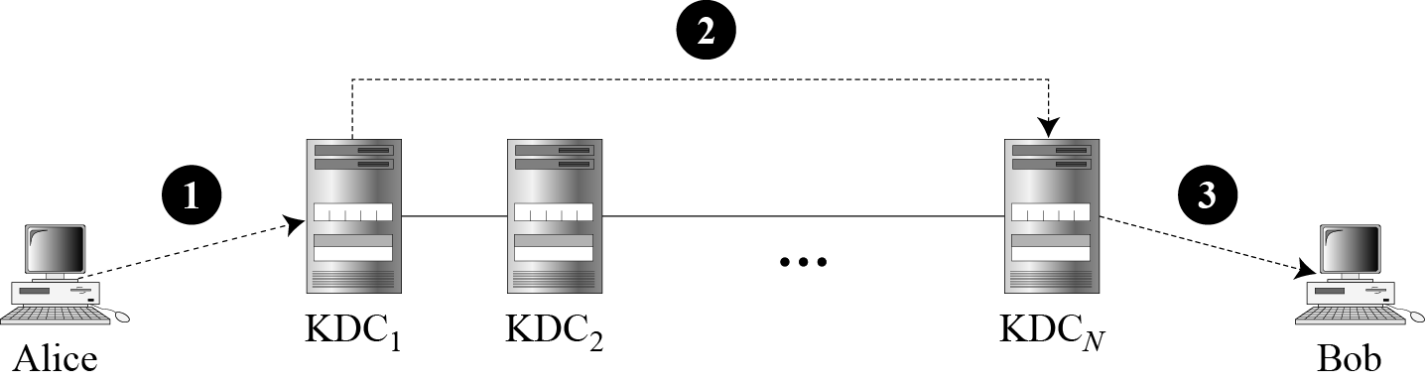
15.1.1 Continued
Flat Multiple KDCs.
Figure 15.2 Flat multiple KDCs
15.<number>

Slide 6
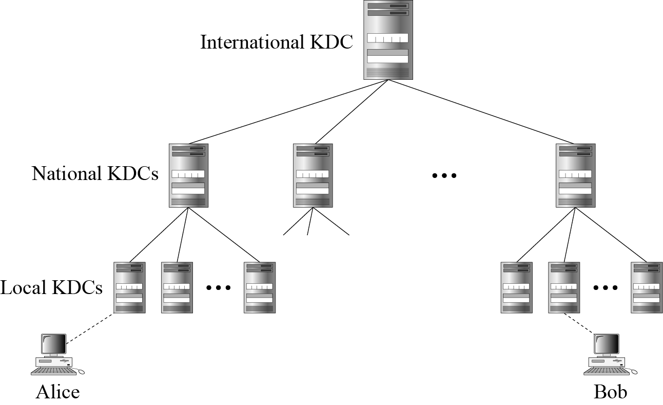
15.1.1 Continued
Hierarchical Multiple KDCs
Figure 15.3 Hierarchical multiple KDCs
15.<number>

Slide 7

15.1.2 Session Keys
A KDC creates a secret key for each member. This secret key can be used only between the member and the KDC, not between two members.
Note
A session symmetric key between two parties is used only once.
15.<number>

Slide 8
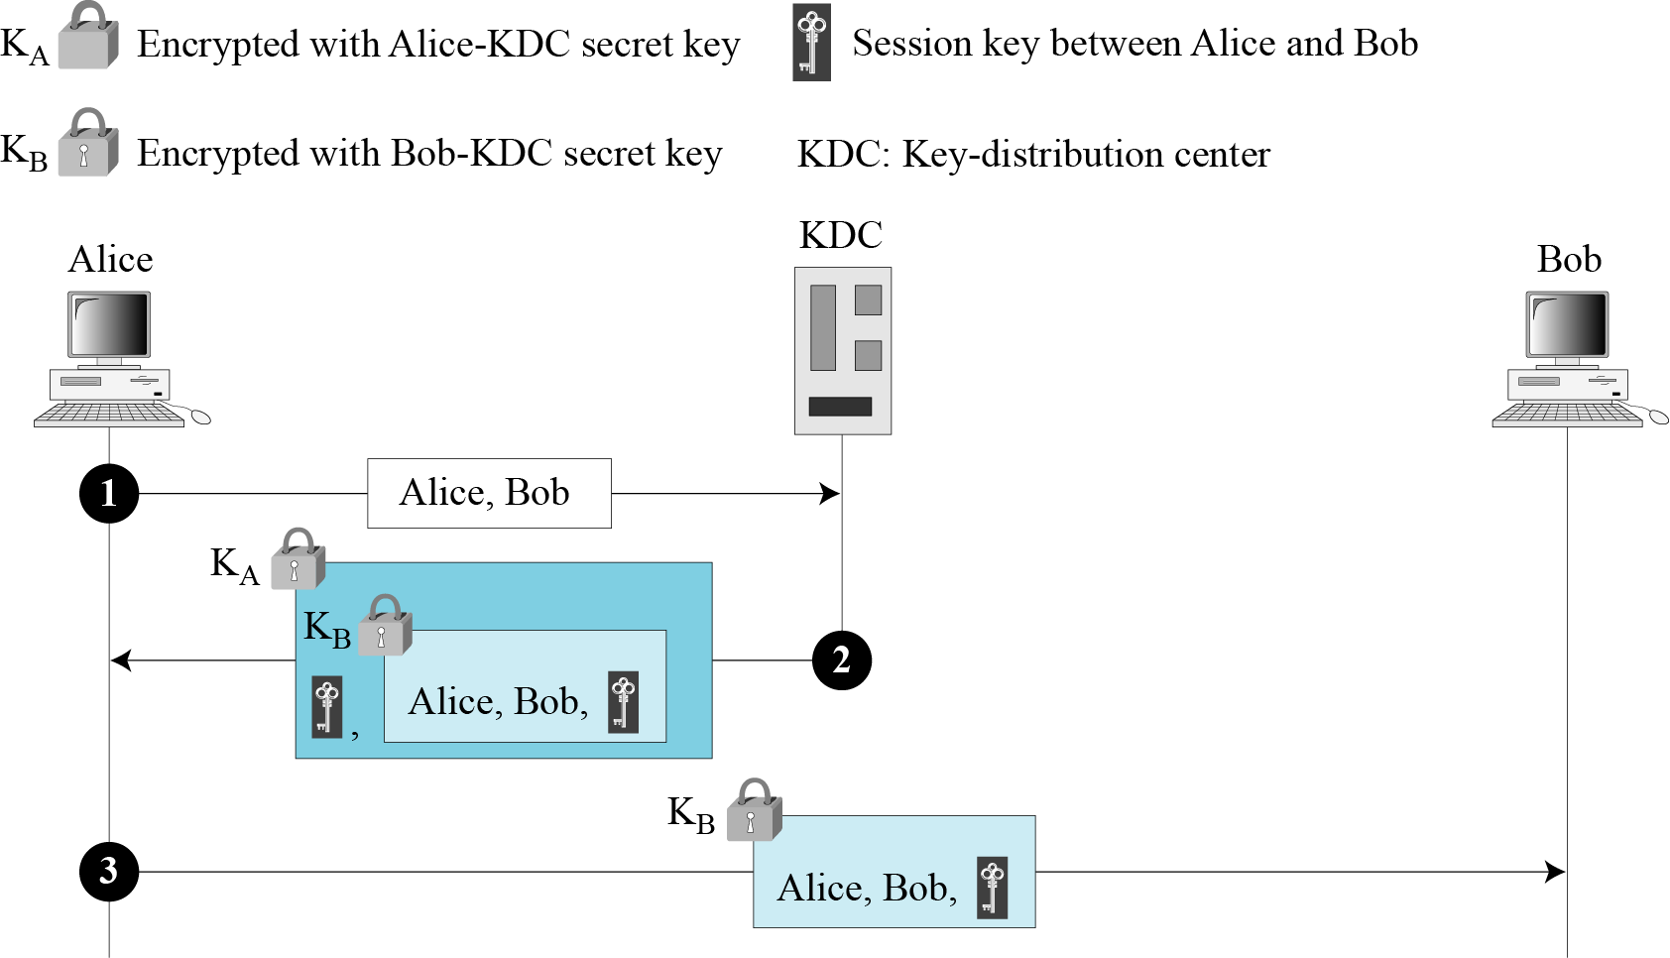
15.1.2 Continued
A Simple Protocol Using a KDC
Figure 15.4 First approach using KDC
15.<number>

Slide 9
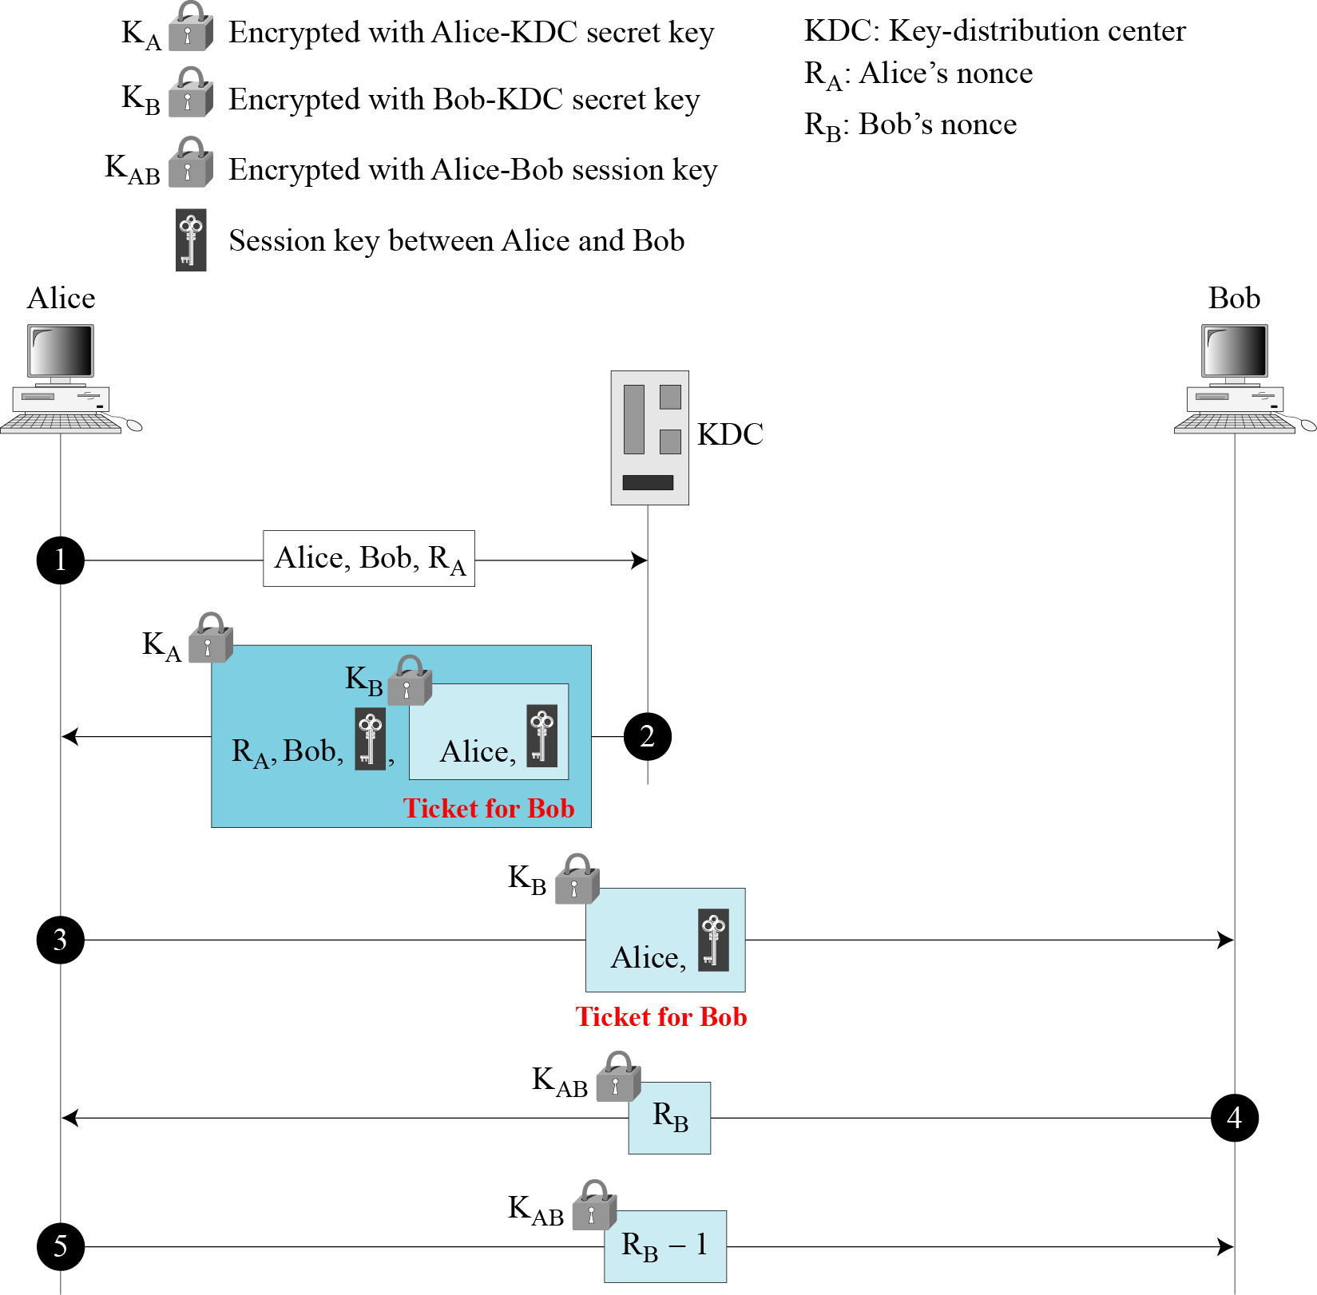
15.1.2 Continued
Needham-Schroeder Protocol
Figure 15.5
Needham-Schroeder
protocol
15.<number>

Slide 10
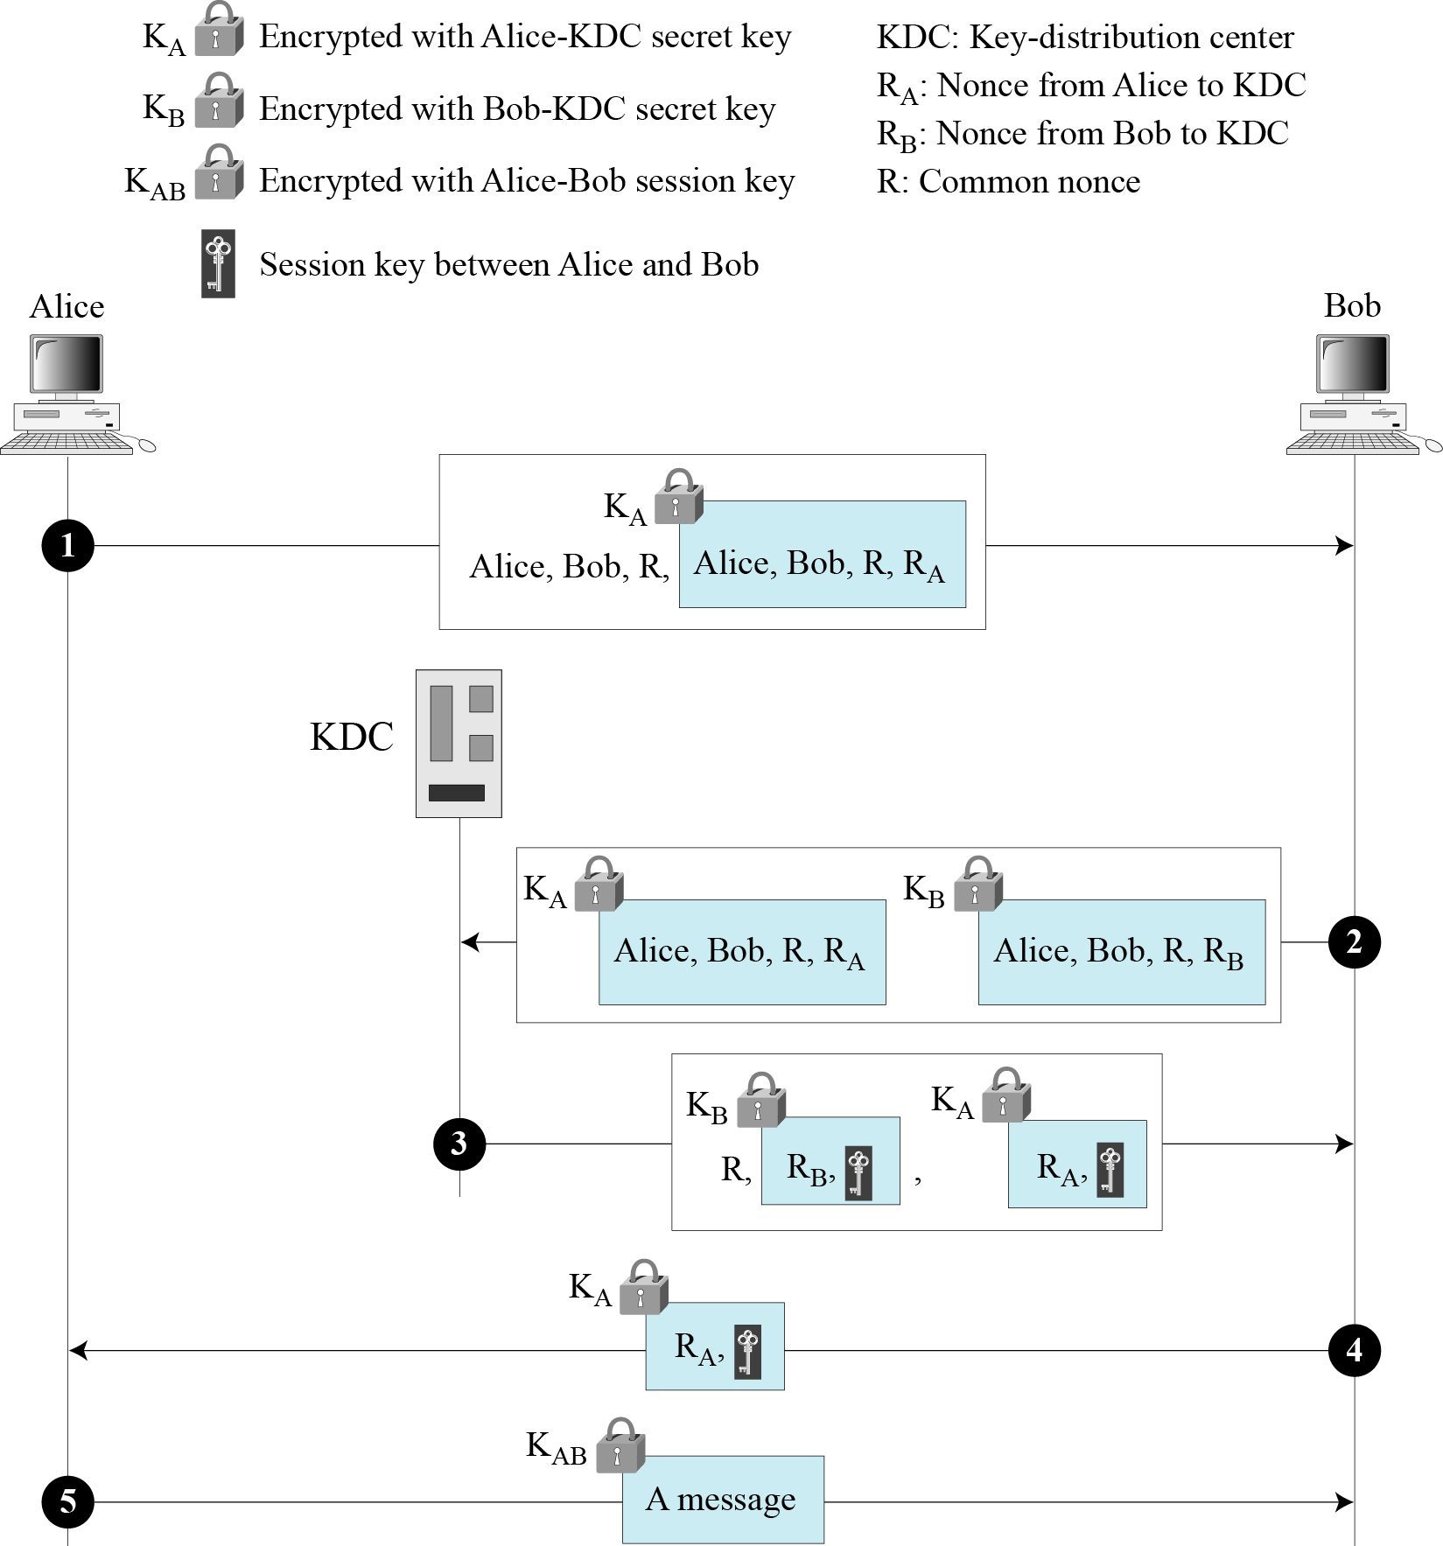
15.1.2 Continued
Otway-Rees Protocol
Figure 15.6
Otway-Rees protocol
15.<number>

Slide 11
15-2 KERBEROS
A backbone network allows several LANs to be connected. In a backbone network, no station is directly connected to the backbone; the stations are part of a LAN, and the backbone connects the LANs.
Kerberos is an authentication protocol, and at the same time a KDC, that has become very popular. Several systems, including Windows 2000, use Kerberos. Originally designed at MIT, it has gone through several versions.
Topics discussed in this section:
15.2.1 Servers
15.2.2 Operation
15.2.3 Using Different Servers
15.2.4 Kerberos Version 5
14.2.5 Realms
15.<number>

Slide 12
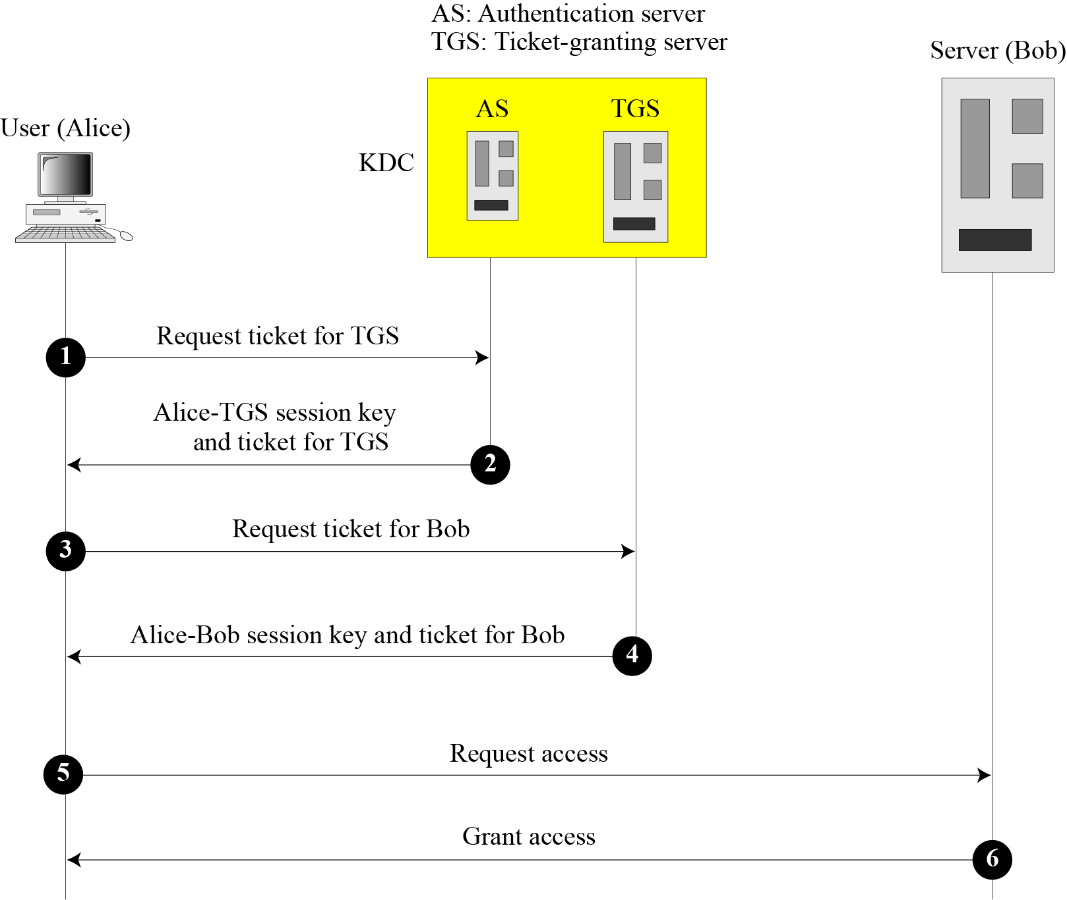
15.2.1 Servers
Figure 15.7 Kerberos servers
15.<number>

Slide 13
15.2.1 Continued
Authentication Server (AS)
The authentication server (AS) is the KDC in the Kerberos protocol.
Ticket-Granting Server (TGS)
The ticket-granting server (TGS) issues a ticket for the real server (Bob).
Real Server
The real server (Bob) provides services for the user (Alice).
15.<number>

Slide 14
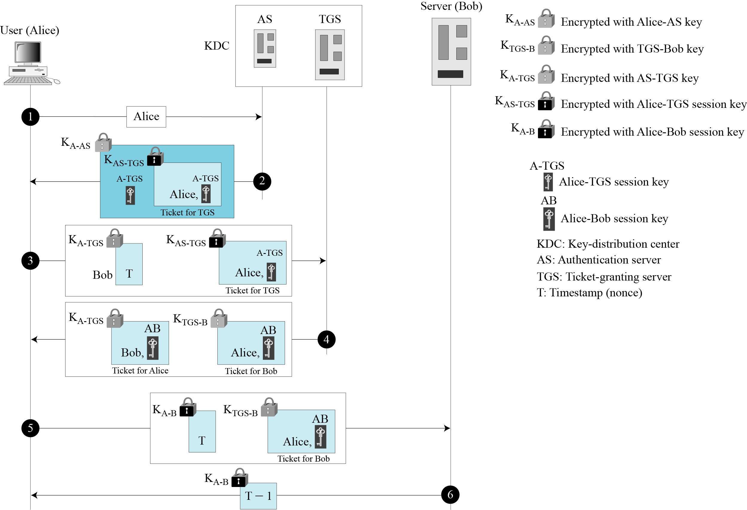
15.2.2 Operation
Figure 15.8 Kerberos example
15.<number>

Slide 15
15.2.3 Using Different Servers
Note that if Alice needs to receive services from different servers, she need repeat only the last four steps.
15.<number>

Slide 16
15.2.4 Kerberos Version 5
The minor differences between version 4 and version 5 are briefly listed below:
Version 5 has a longer ticket lifetime.
Version 5 allows tickets to be renewed.
Version 5 can accept any symmetric-key algorithm.
Version 5 uses a different protocol for describing data types.
Version 5 has more overhead than version 4.
15.<number>

Slide 17
15.2.5 Realms
Kerberos allows the global distribution of ASs and TGSs, with each system called a realm. A user may get a ticket for a local server or a remote server.
15.<number>

Slide 18
15-4 PUBLIC-KEY DISTRIBUTION
In asymmetric-key cryptography, people do not need to know a symmetric shared key; everyone shields a private key and advertises a public key.
Topics discussed in this section:
15.4.1 Public Announcement
15.4.2 Trusted Center
15.4.3 Controlled Trusted Center
15.4.4 Certification Authority
15.4.5 X.509
15.4.6 Public-Key Infrastructures (PKI)
15.<number>

Slide 19
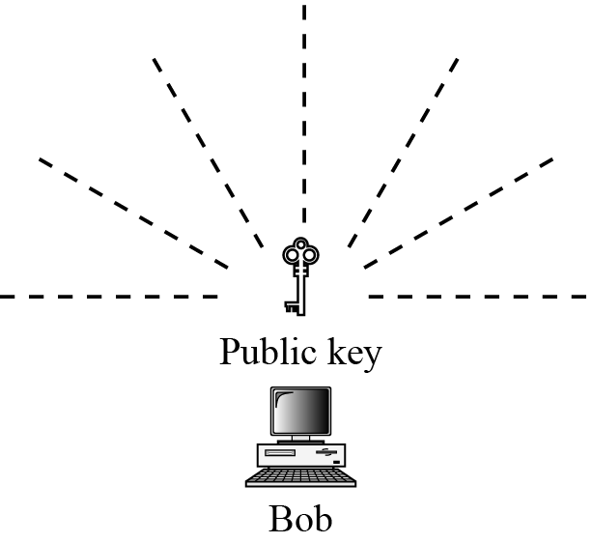
15.4.1 Public Announcement
Figure 15.13 Announcing a public key
15.<number>

Slide 20
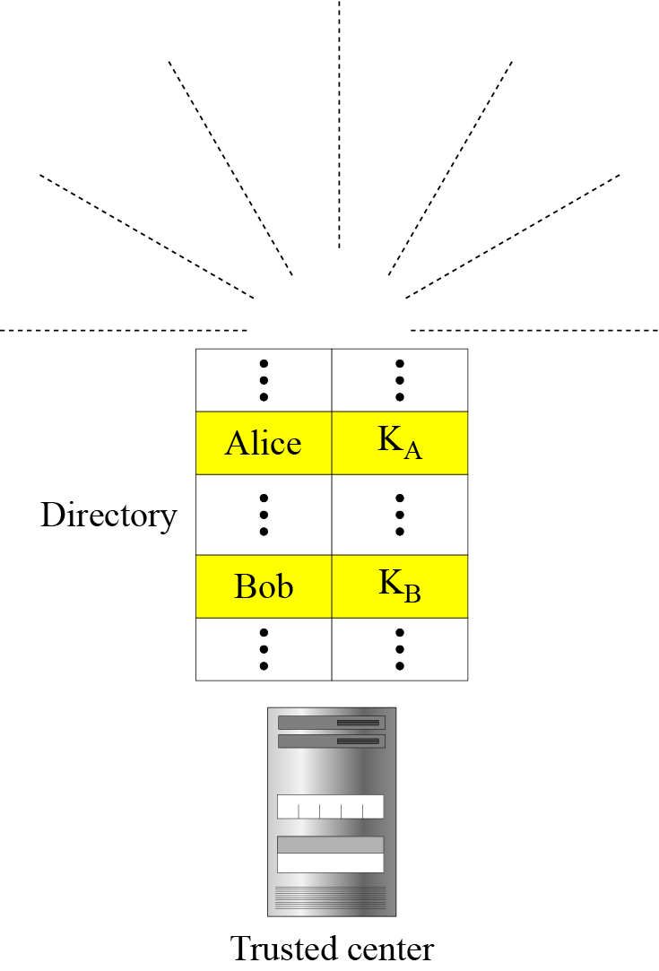
15.4.2 Trusted Center
Figure 15.14 Trusted center
15.<number>

Slide 21
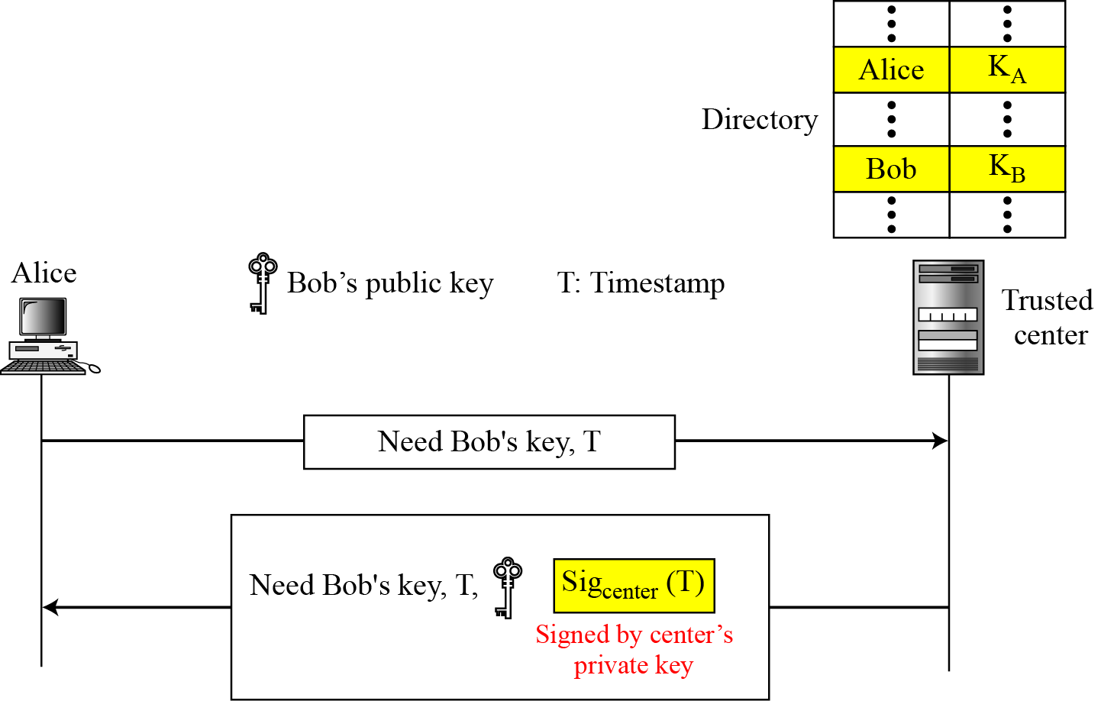
15.4.3 Controlled Trusted Center
Figure 15.15 Controlled trusted center
15.<number>

Slide 22
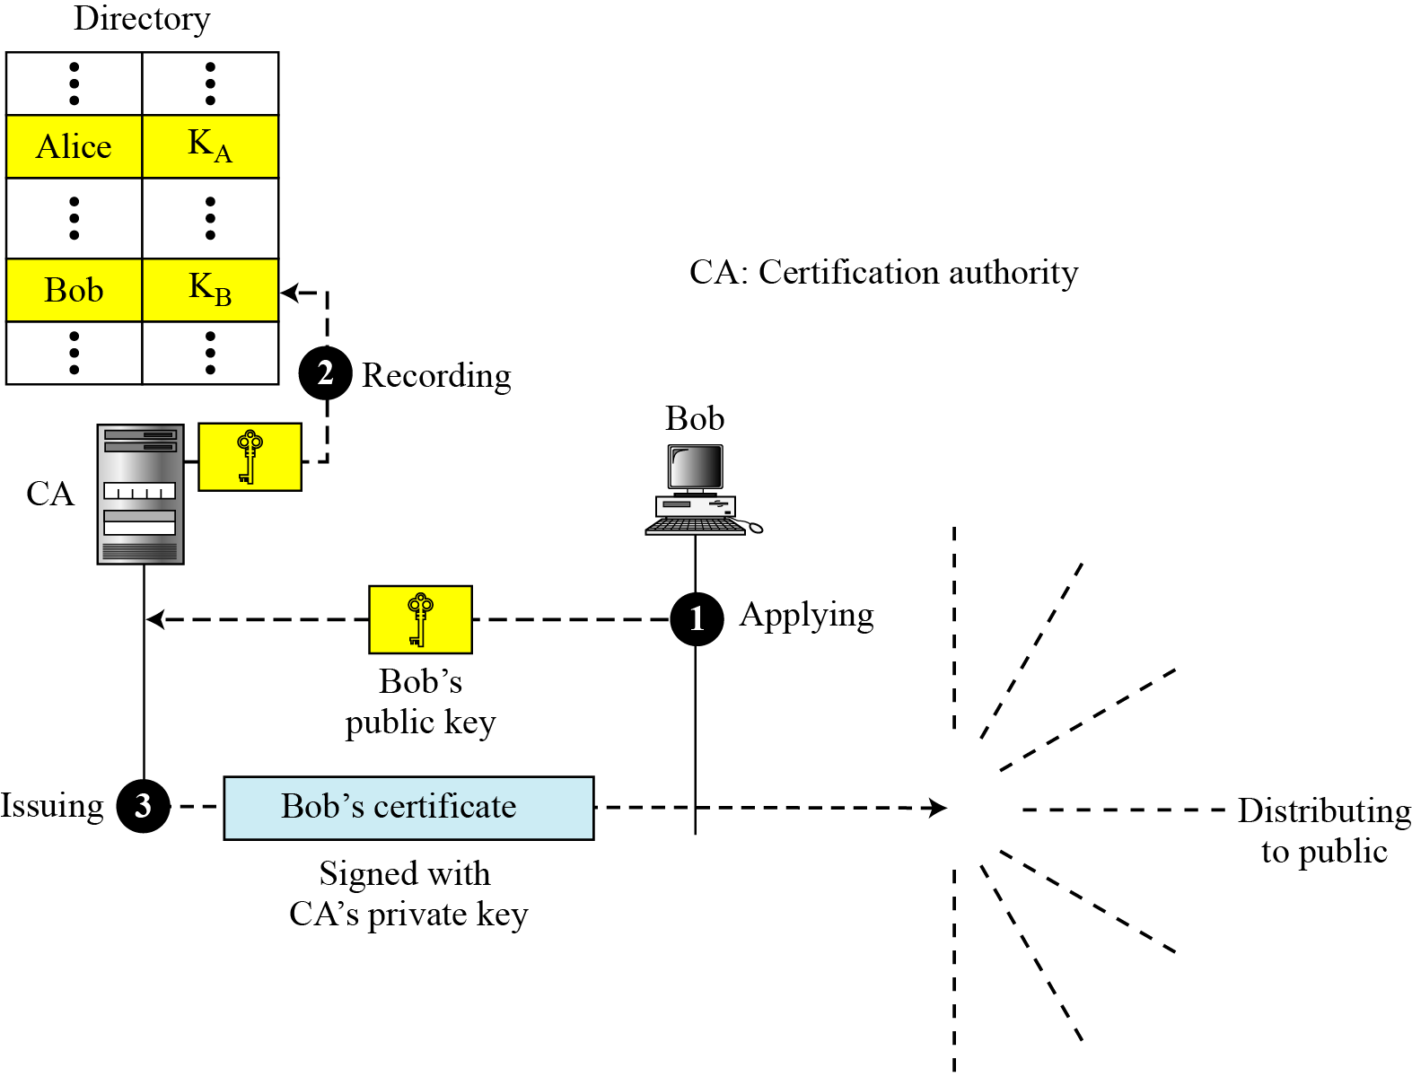
15.4.4 Certification Authority
Figure 15.16 Certification authority
15.<number>

Slide 23
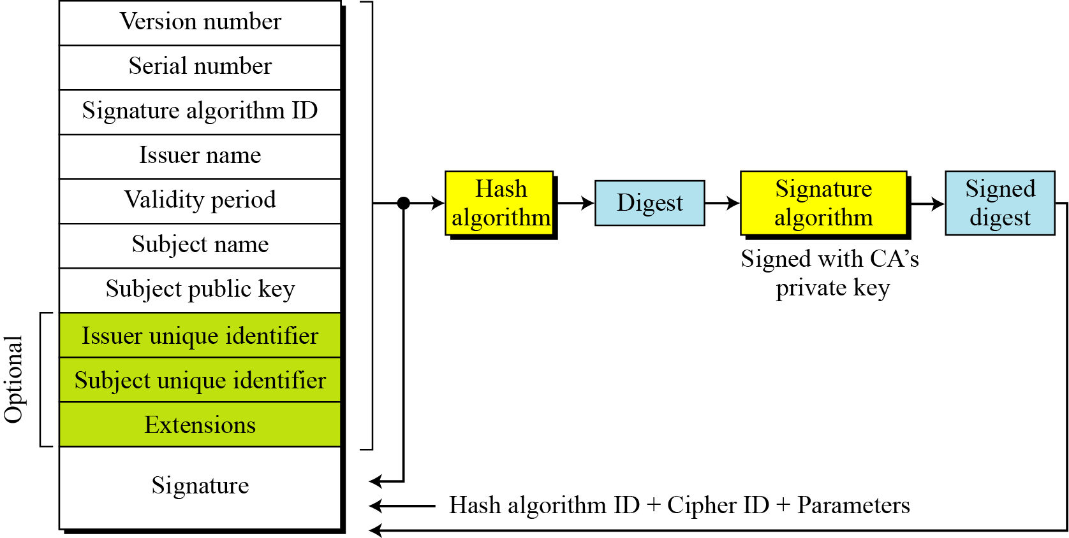
15.4.5 X.509
Certificate
Figure 15.17 shows the format of a certificate.
15.<number>

Slide 24
15.4.5 Continued
Certificate Renewal
Each certificate has a period of validity. If there is no problem with the certificate, the CA issues a new certificate before the old one expires.
Certificate Revoke
In some cases a certificate must be revoked before its expiration.
15.<number>

Slide 25
15.4.5 Continued
Figure 15.18 Certificate revocation format
Signature algorithm ID
Issuer name
This update date
Next update date
Revoked Certificate
.
.
Revoked Certificate
15.<number>

Slide 26
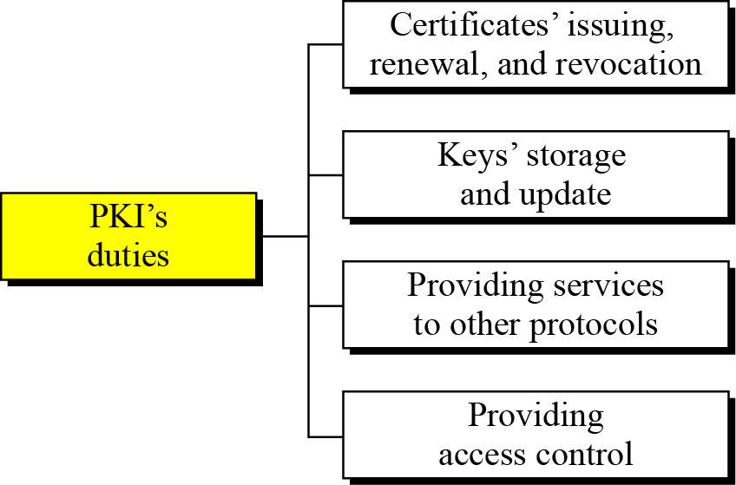
15.4.6 Public-Key Infrastructures (PKI)
Figure 15.19 Some duties of a PKI
15.<number>

Slide 27
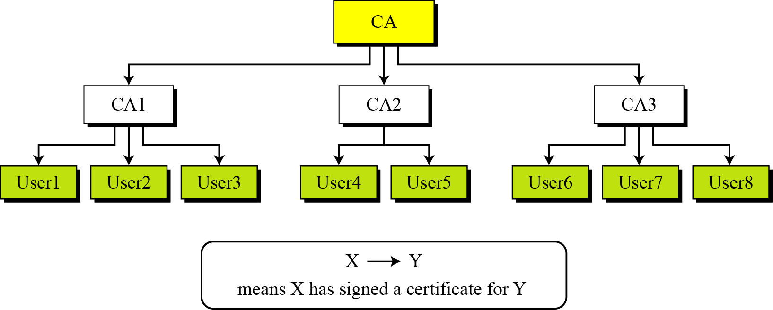
15.4.6 Continued
Trust Model
Figure 15.20 PKI hierarchical model
15.<number>

Slide 28
15.4.6 Continued
Example 15.3
Show how User1, knowing only the public key of the CA (the root), can obtain a verified copy of User3’s public key.
Solution
User3 sends a chain of certificates, CA<<CA1>> and CA1<<User3>>, to User1.
a. User1 validates CA<<CA1>> using the public key of CA.
b. User1 extracts the public key of CA1 from CA<<CA1>>.
c. User1 validates CA1<<User3>> using the public key of CA1.
d. User1 extracts the public key of User 3 from CA1<<User3>>.
15.<number>

Slide 29
15.4.6 Continued
Example 15.4
Some Web browsers, such as Netscape and Internet Explorer, include a set of certificates from independent roots without a single, high-level, authority to certify each root. One can find the
list of these roots in the Internet Explorer at Tools/Internet Options/Contents/Certificate/Trusted roots (using pull-down menu). The user then can choose any of this root and view the certificate.
15.<number>

Slide 30
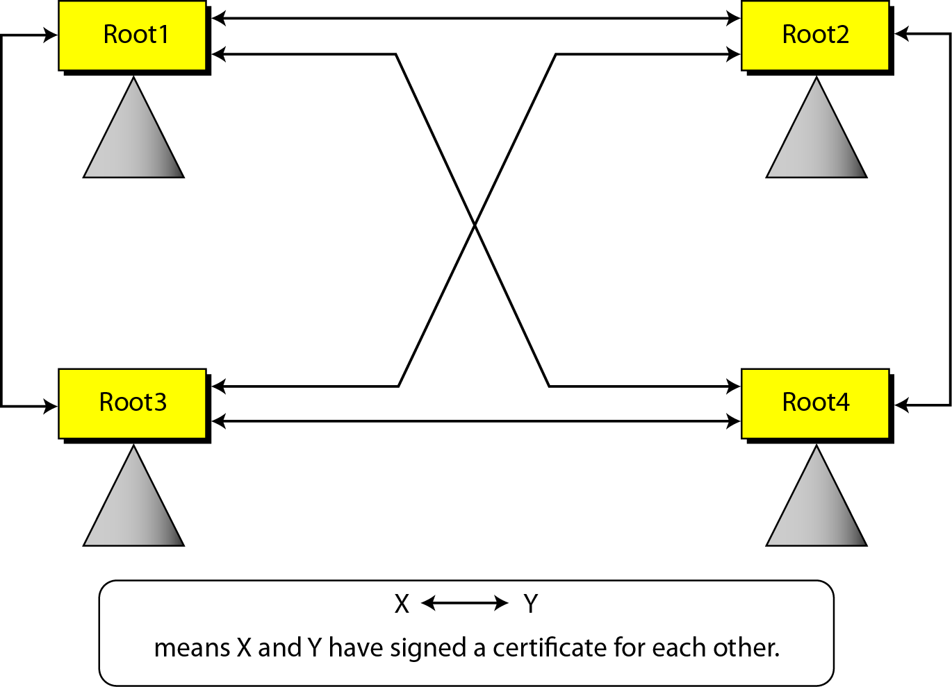
15.4.6 Continued
Figure 15.21 Mesh model
15.<number>

Slide 31
15.4.6 Continued
Example 15.5
Alice is under the authority Root1; Bob is under the authority Root4. Show how Alice can obtain Bob’s verified public key.
Solution
Bob sends a chain of certificates from Root4 to Alice. Alice looks at the directory of Root1 to find Root1<< Root4>> and
Root4<<Bob>> certificates. Using the process shown in Figure below, Alice can verify Bob’s public key.
Alice
Bob
15.<number>

